Slide 1
Fizz Wizards
Swire Coca-Cola Capstone Presentation
Greg Francom
Sai Anogna Chittudi
Sushma Sree Mutyapu
Tom Kingston

Slide 2

Business Setting
How can Swire anticipate demand for their innovation products?

Slide 3

Discover the most accurate model to anticipate demand for the innovation products

Slide 4
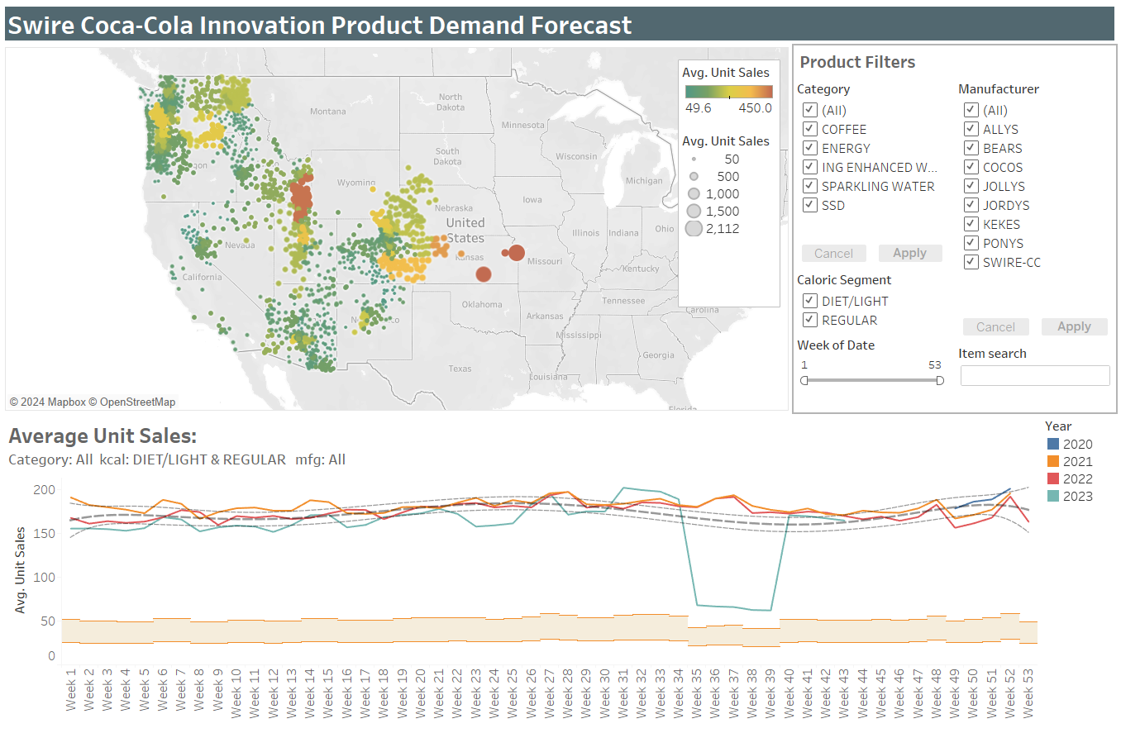
Tableau Dashboard
Average unit sales by locations and yearly trends
Filters:
Geography
Category
Calorie
Manufacturer
Date
Item search

Slide 5
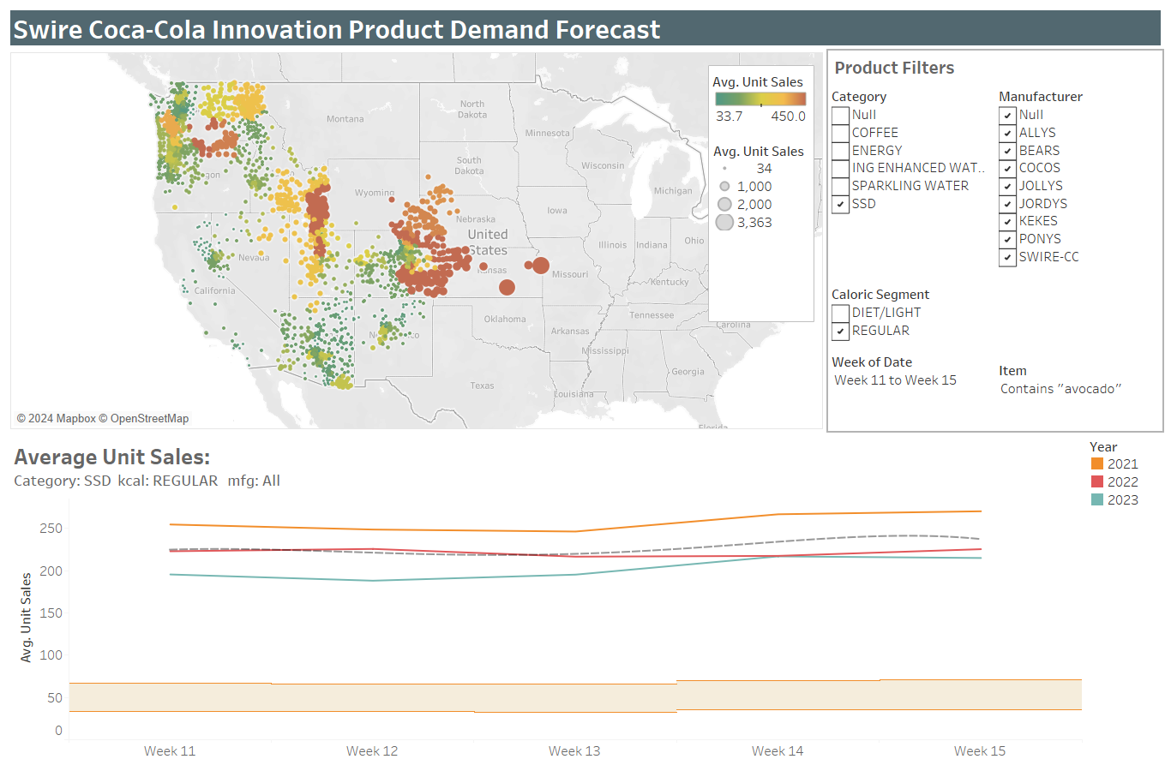
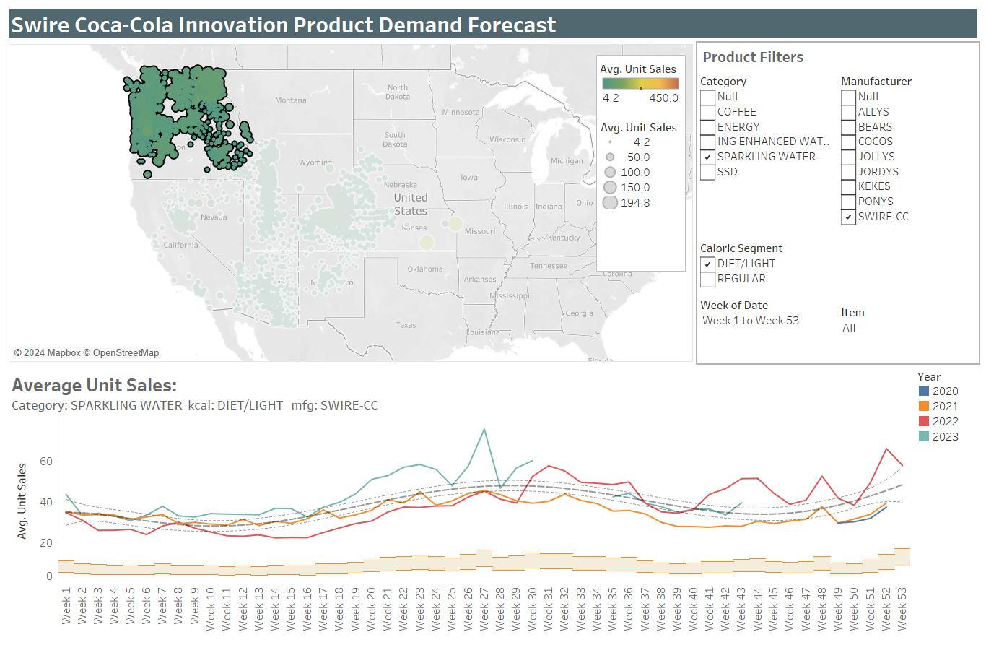
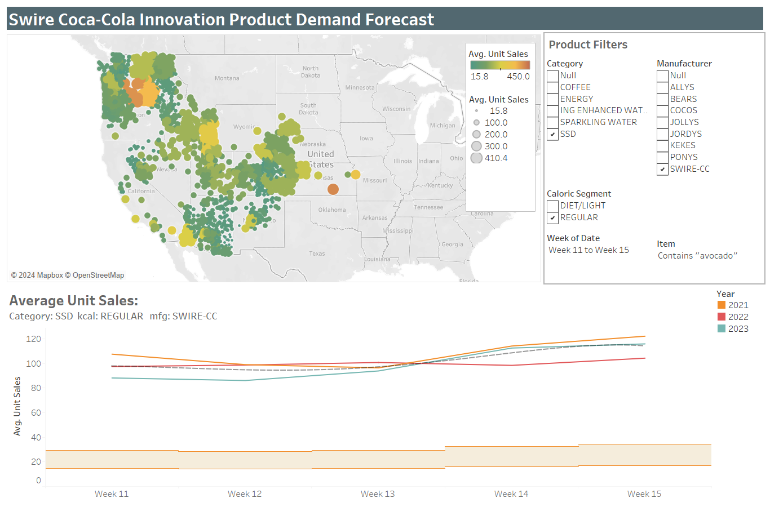
Tableau Dashboard
Q2: Sparkling Jacceptabletlester Avocado
Regular, SSD, Swire-CC, ‘Avocado’
Two weeks prior and post Easter
Q4: Diet Mulberries Sparkling Water
Diet, Sparkling Water, Swire-CC
Release one year, Northern region
Notes:
Dashboard allows a visual of outliers, trends, changes over time, and most importantly – select and segment the data allowing users to begin to answer the proposed questions.
The orange band at the bottom is a reference band based on a selected percentage of the displayed average unit sales.

Slide 6
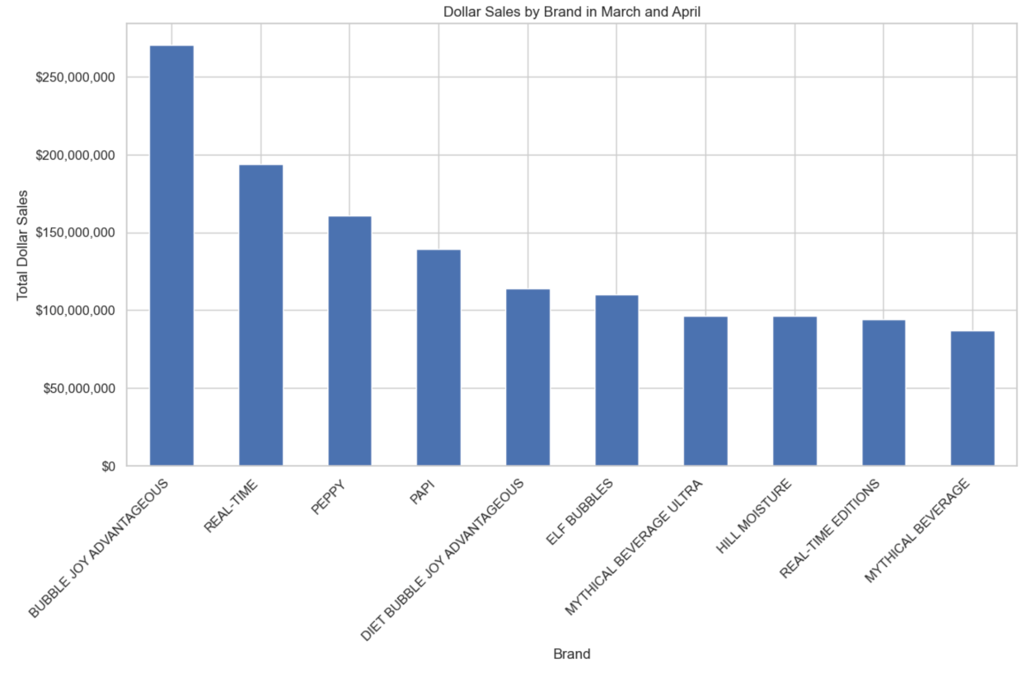
Dollar Sales by Brand in March and April

Slide 7
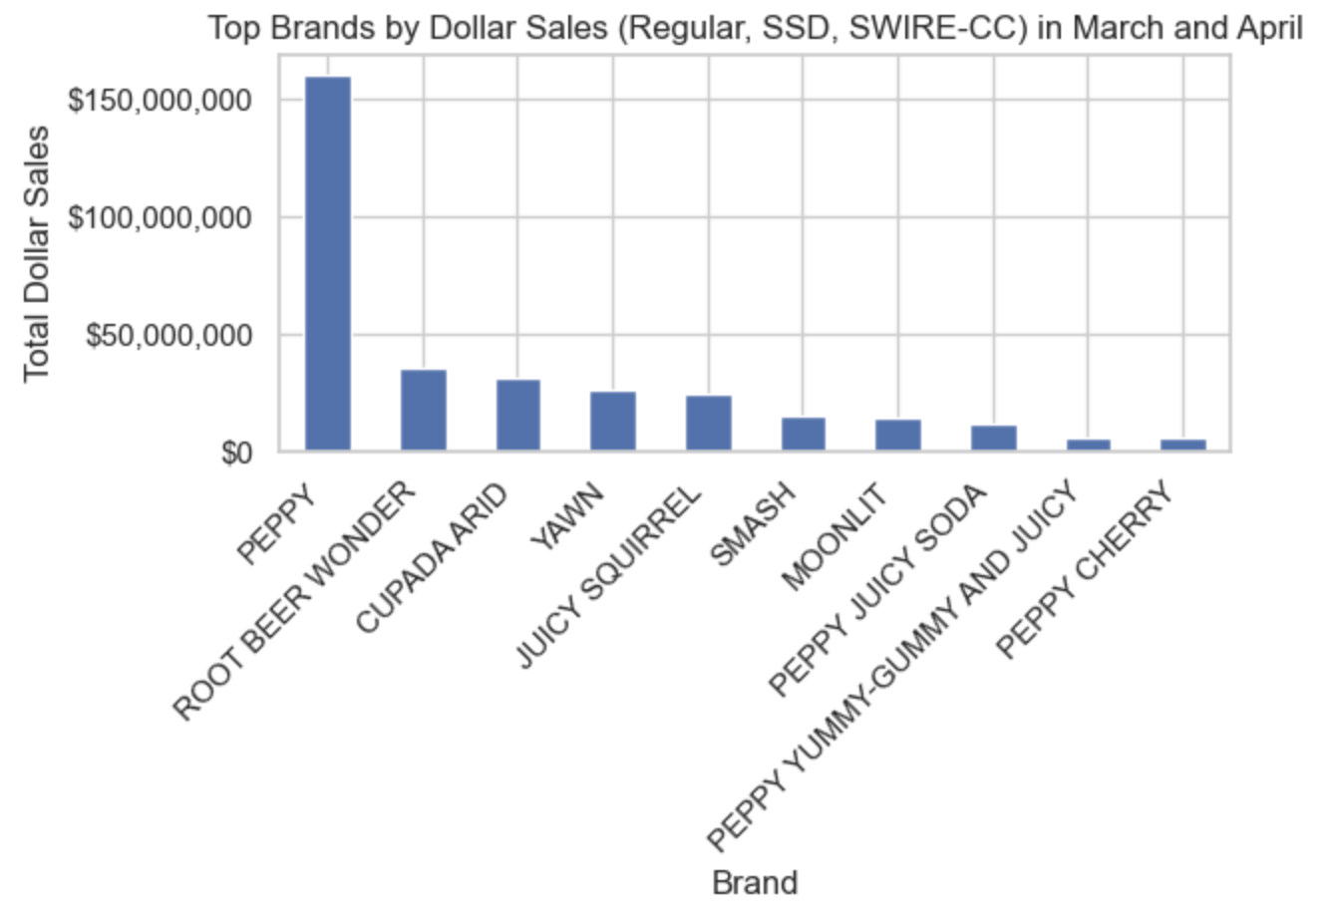
Top Dollar Sales by Brand in March and April
(filtered for Regular, SSD)
The filtering has changed the Total Sales value for each of the brand.
This proves that filtering the data to the new Products specifications is really important for getting the good Results.

Slide 8
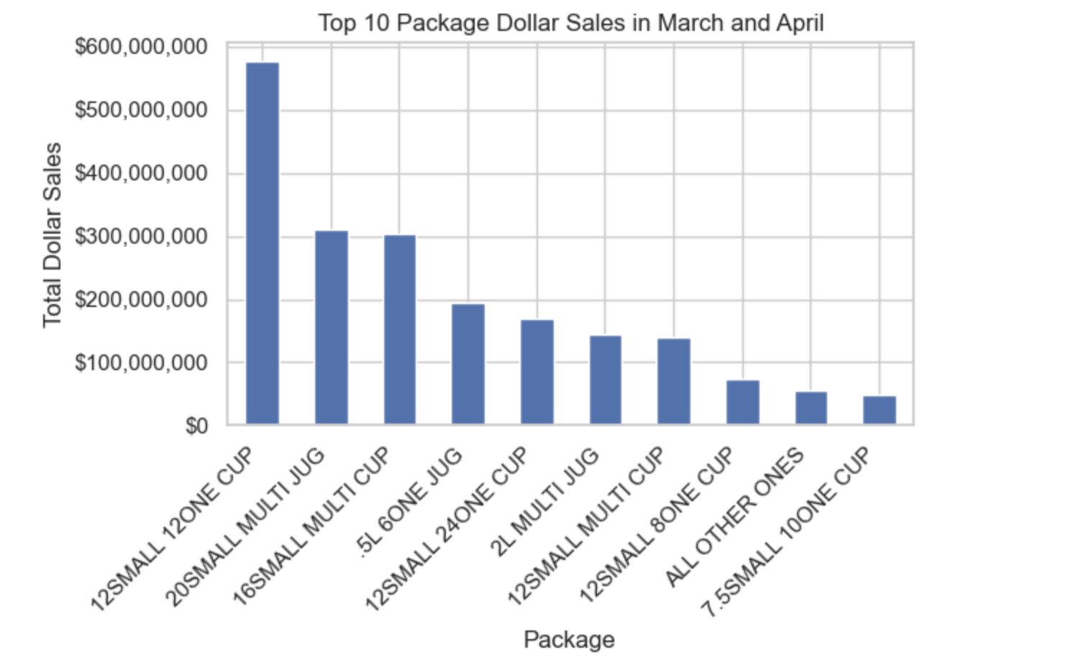
Top Dollar Sales by Package in March and April

Slide 9
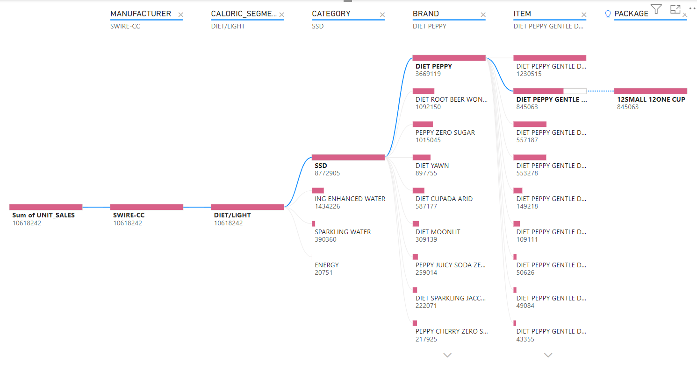
Product Clustering

Slide 10
Modeling Considerations
Random Forest
Robust to overfitting and outliers
XG Boost
Maximizes predictive accuracy.
ARIMA
Temporal Sensitive by incorporating both autoregressive and moving average components.
Prophet
Seamlessly integrating multiple seasonal, holiday components and flexible trend modeling.

Slide 11
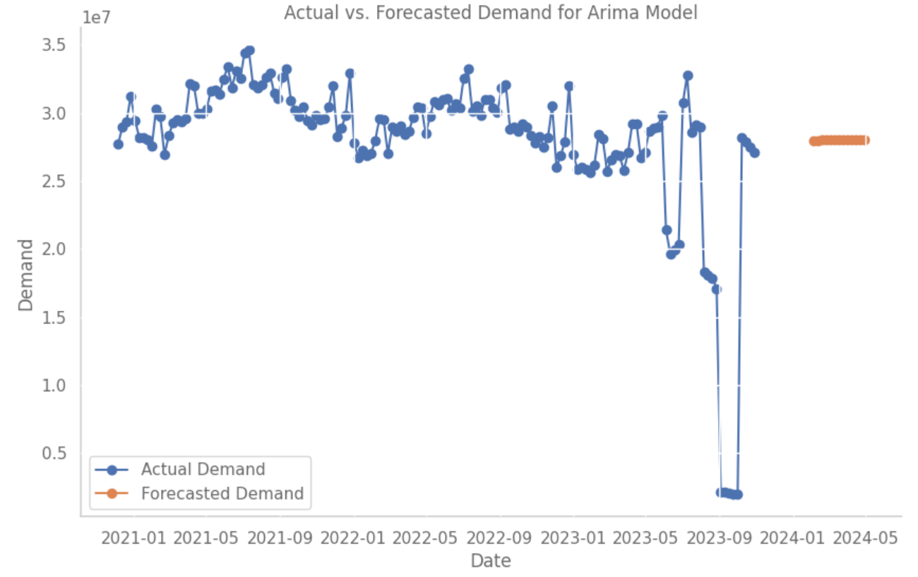
ARIMA Model
Highest 13 weeks Forecast Demand Start Period: 2024-02-04 End Period: 2024-04-28

Slide 12
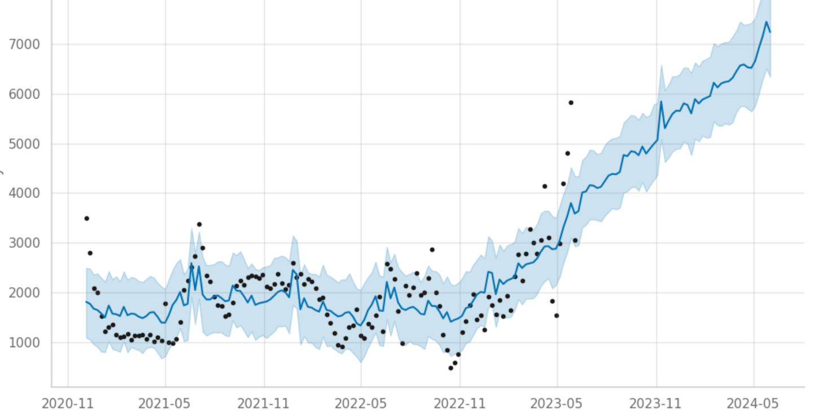
Prophet Model
Highest 13 weeks Forecast Demand Start Period: 2024-10-19 End Period: 2025-01-18
The total forecast in demand in unit sales for those weeks is estimated to be 117786.38

Slide 13
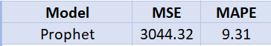
Modeling Results

Slide 14
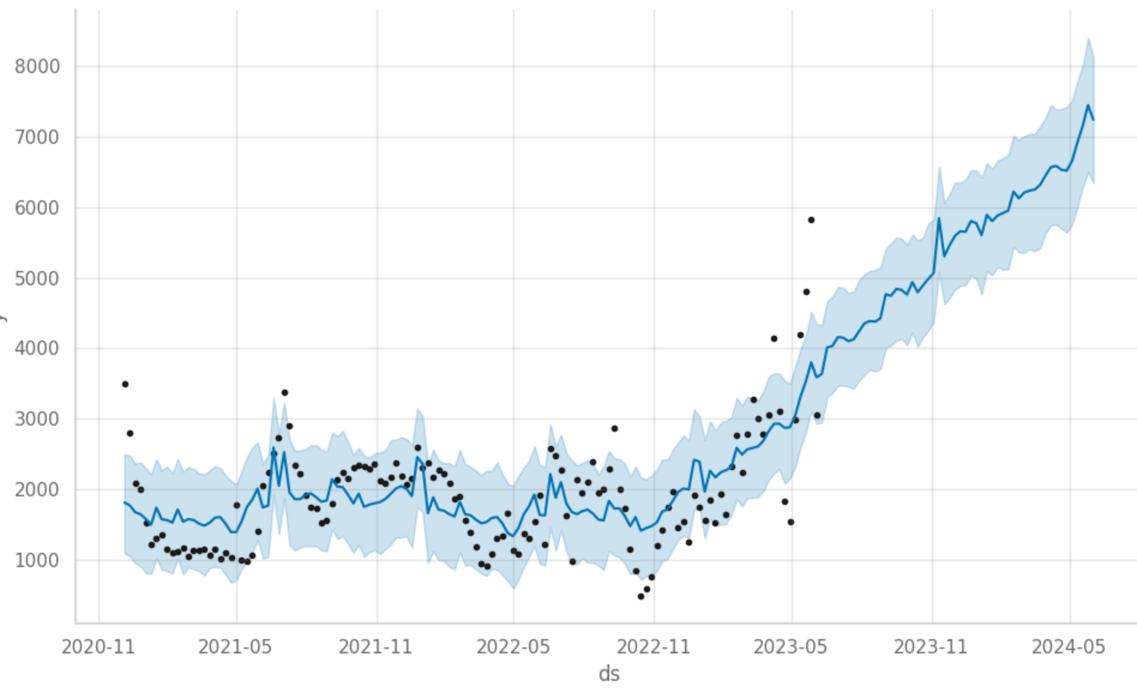
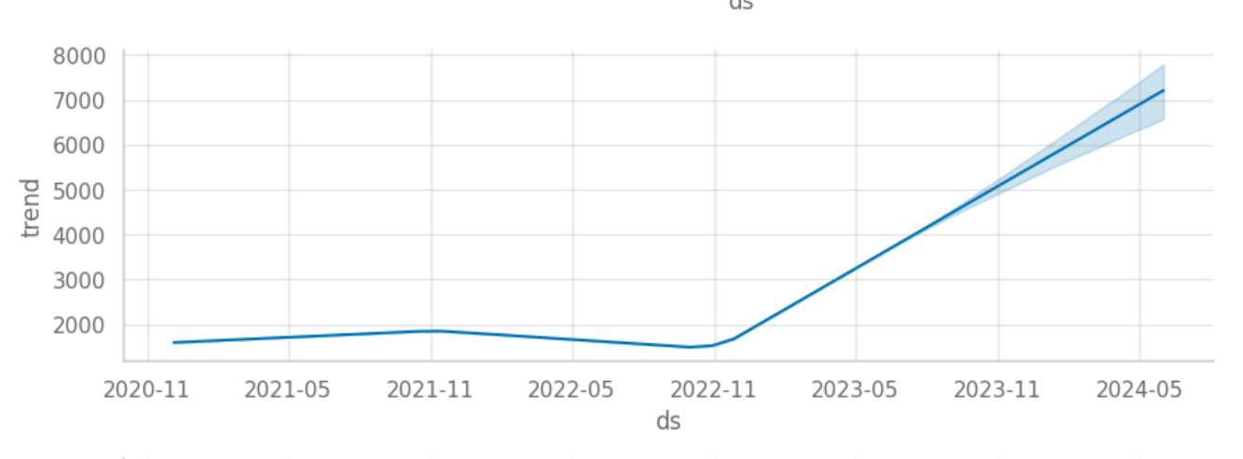
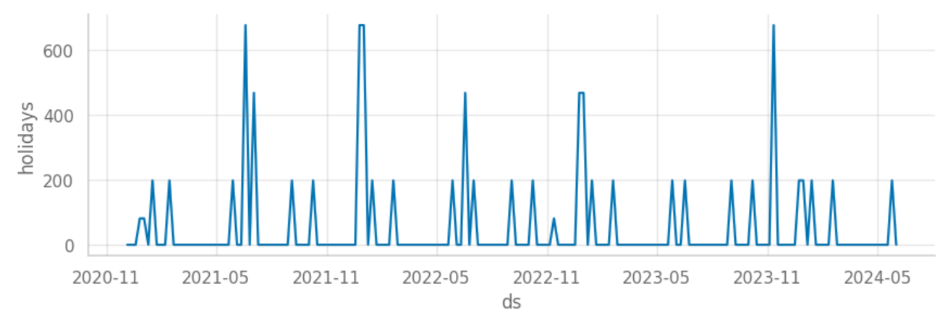
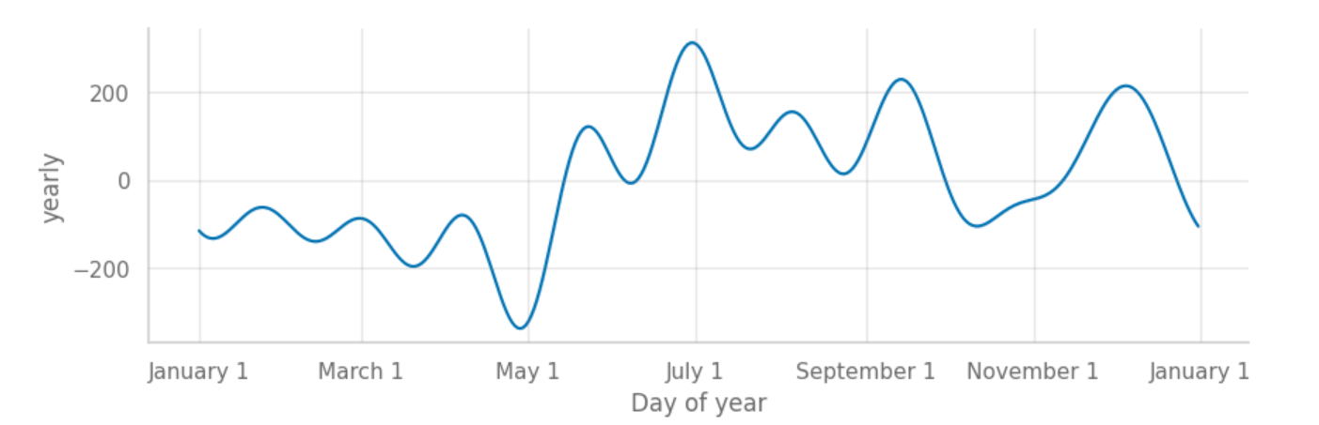
Question 1 - Diet, SSD, Plum - Best 13 weeks

Slide 15
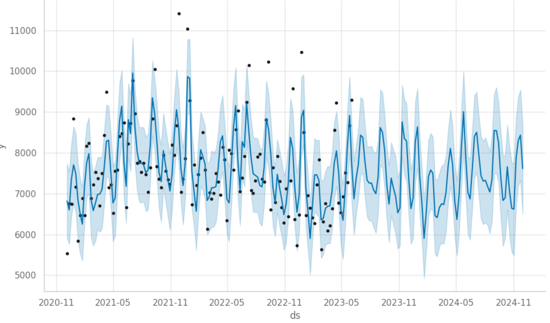
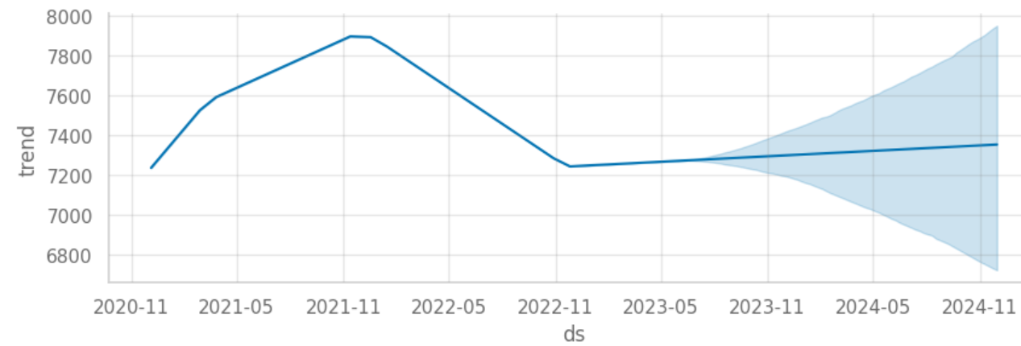
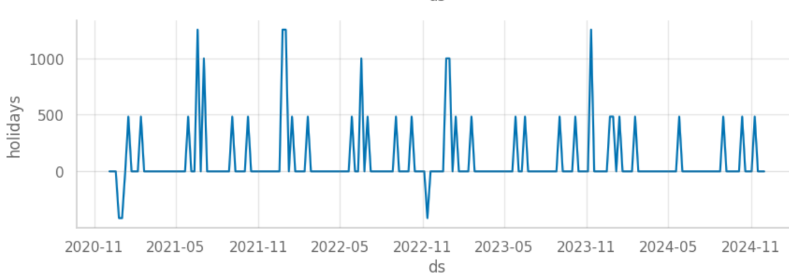
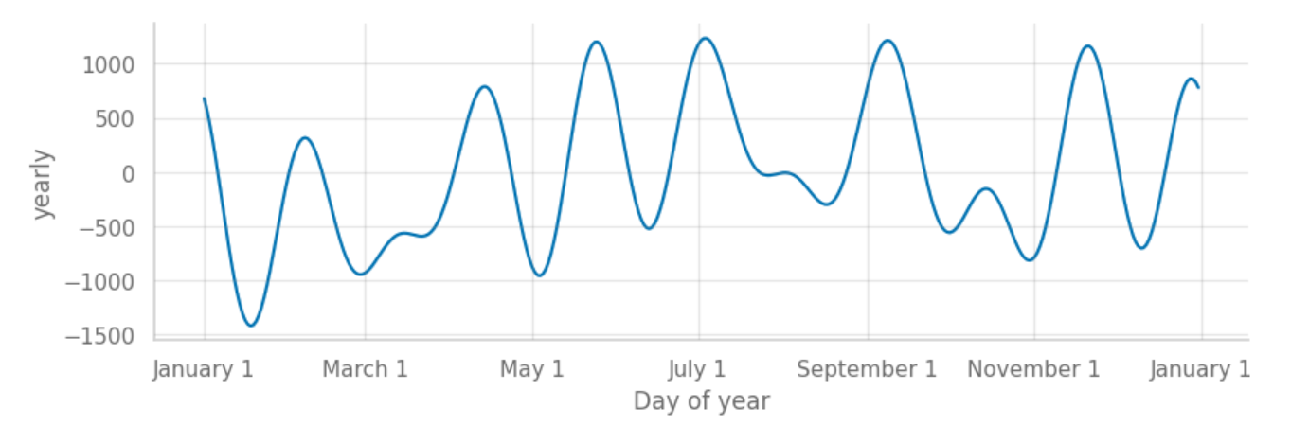
Question 2 - Regular, SSD, Avocado - Easter Time

Slide 16
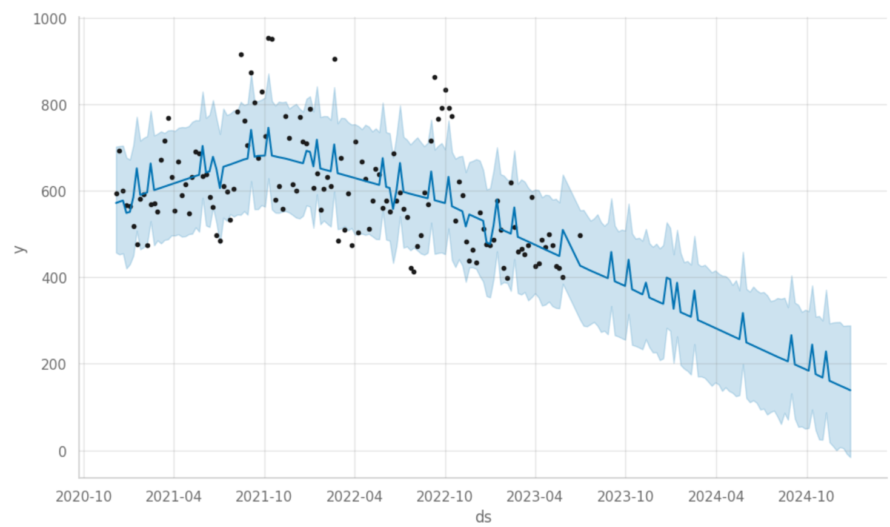
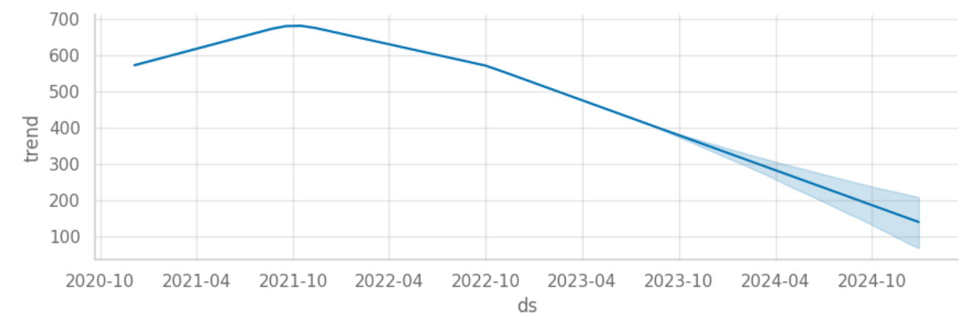
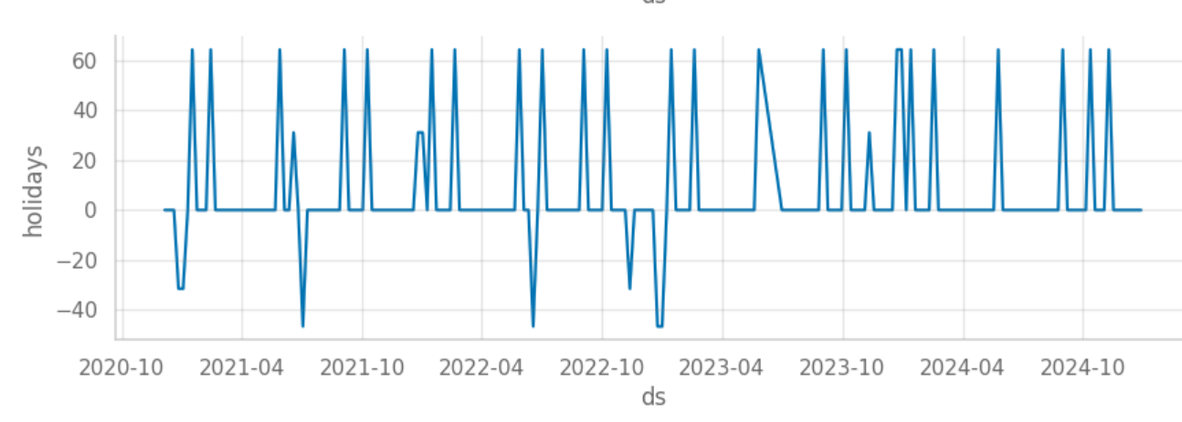
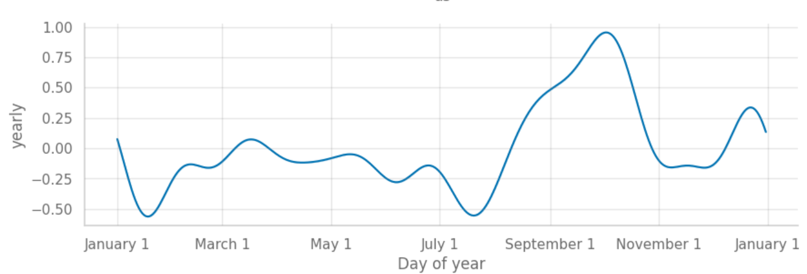
Question 3 - Diet, Energy, Kiwano - Best 13 weeks

Slide 17
Future Scope
Adding new categorical variables into the prophet model
Adding Region wise analysis for the Forecasting
Increasing the processing efficiency by introducing the optimizing algorithms for parallel processing

Slide 18
Thank you
Questions ?

Slide 20
Appendix:
Q2: Sparkling Jacceptabletlester Avocado 11Small MLT
Regular
SSD
Swire-CC
Sparkling Jacceptabletlester
11Small MLT
Flavor: ‘Avocado’
Release two weeks prior and two weeks post Easter.

Slide 21
Appendix:
Q4: Diet Mulberries Sparkling Water
Diet
Sparkling Water
Swire-CC
Square
10Small MLT
Flavor: ‘Mulberries
Release one year, exclusively in the Northern region

Slide 22
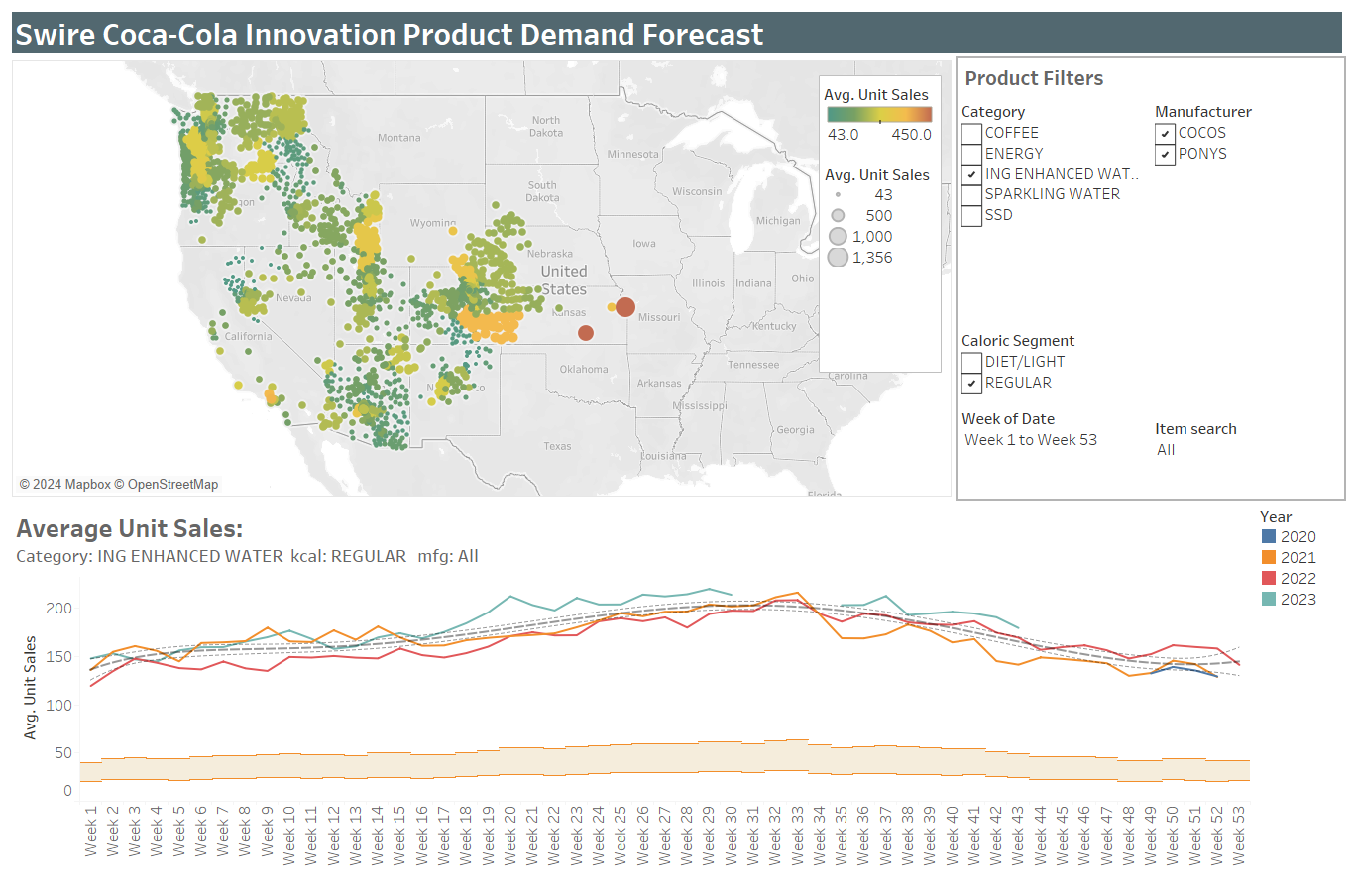
Appendix:
Q5: Greetingle Health Beverage Woodsy Yellow .5L 12One Jug
Regular
ING Enhanced Water
Swire-CC
Greetingle
.5L 12One Jug
Flavor: ‘Woodsy Yellow’
Release for 13 weeks, optimal region

Slide 23
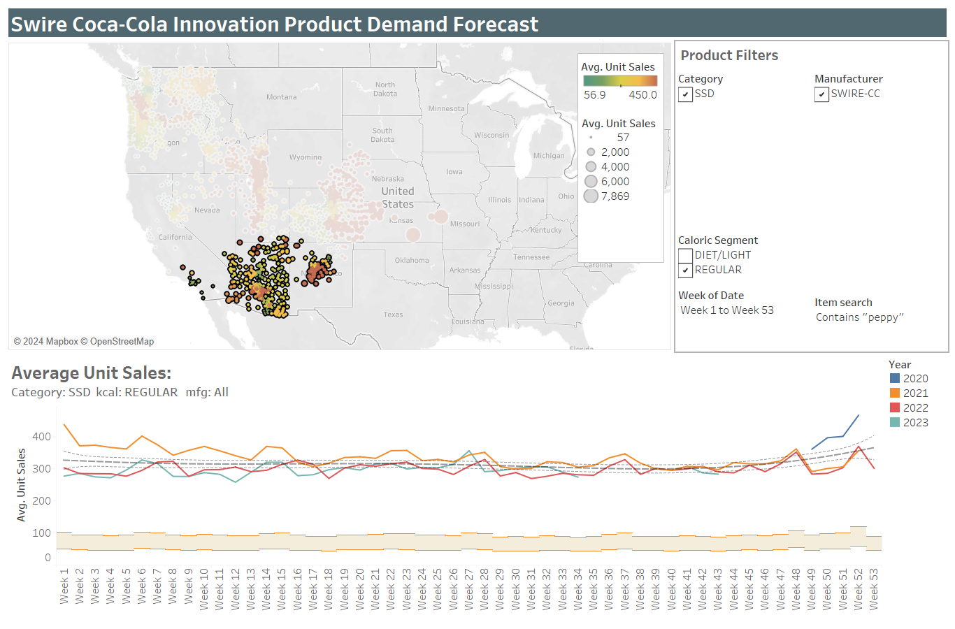
Appendix:
Q7: Peppy Gentle Drink Pink Woodsy .5L Multi Jug
Regular
SSD
Swire-CC
Peppy
.5L Multi Jug
Flavor: ‘Pink Woodsy’
Release in the Southern region for 13 weeks.

